Slide 1

Hearts & Paws
- Kshitij Mahajan - Project Manager
- Kunal Tajne - Product Owner
- Harshitha Ettam - Business Analyst
- Rishita Gupta - Lead Developer
- Ritik Kale – Developer
- Vrushali Tambat - Developer
- Atharv Patole - DBA
- Deepak Vemula - QA Analyst
- Lasya Priya Bhavanchikar - Software Tester
- Vishnu Vardan Pentela - Software Tester

Slide 2
AGENDA
❖BRM Diagram
❖Context Diagram
❖RoadMap
❖RCT (main view only)
❖User Stories
❖UML Activity Diagram
❖ER Diagrams
❖Burndown Charts
❖Jenkins Progress Report
❖Live [Recorded] Application Demo

Slide 3
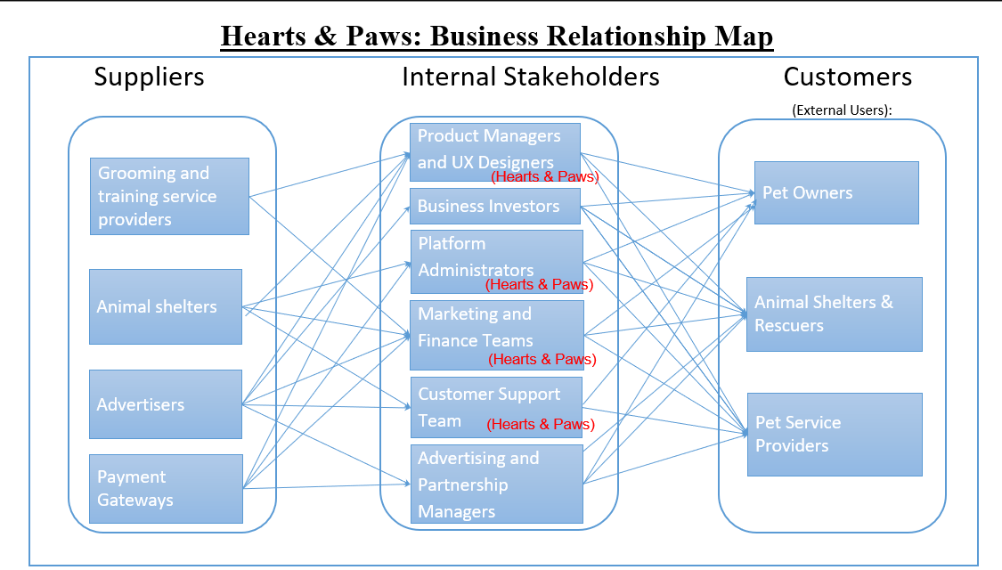
BRM DIAGRAM (Harshitha Ettam)

Slide 4
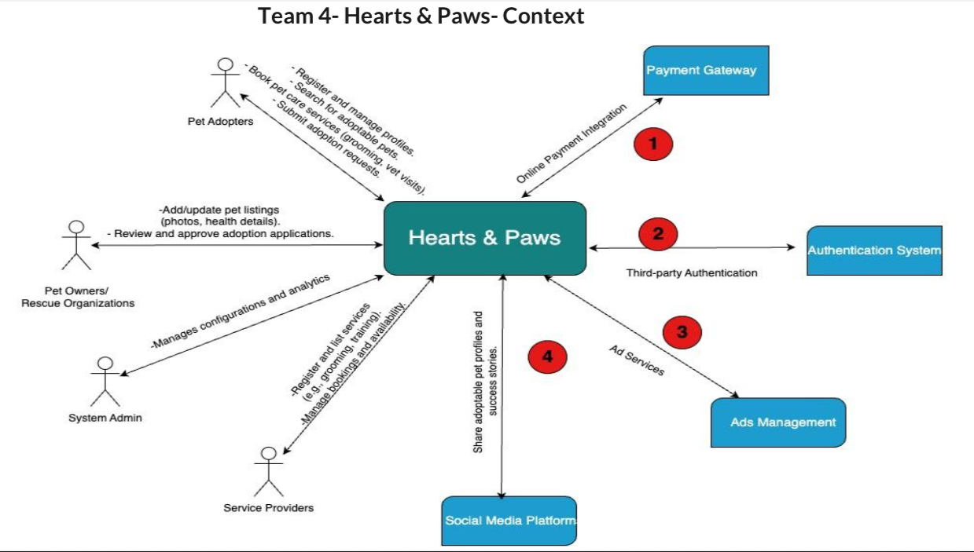
CONTEXT DIAGRAM (Atharv Patole)

Slide 5
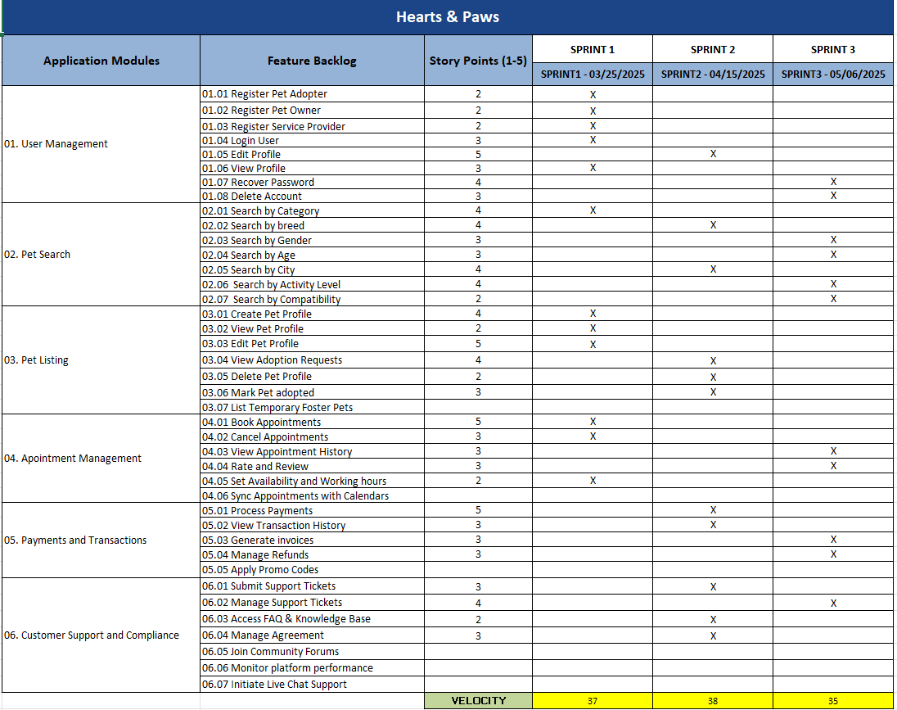
ROAD MAP (Kunal Tajne)

Slide 6
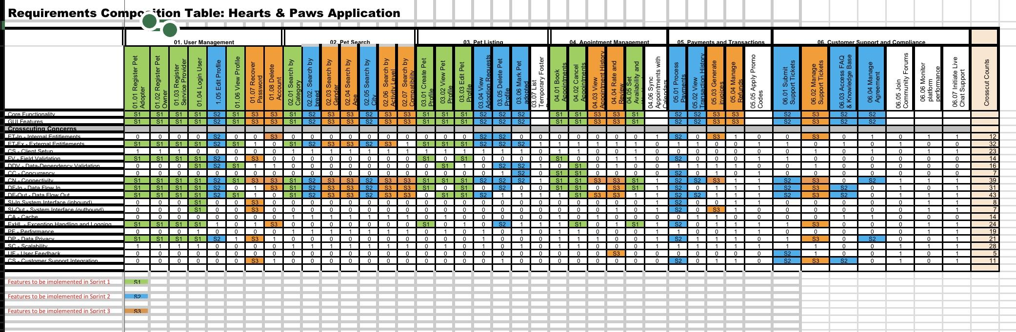
RCT: Main View (Vrushali Tambat, Rishita Gupta)

Slide 7
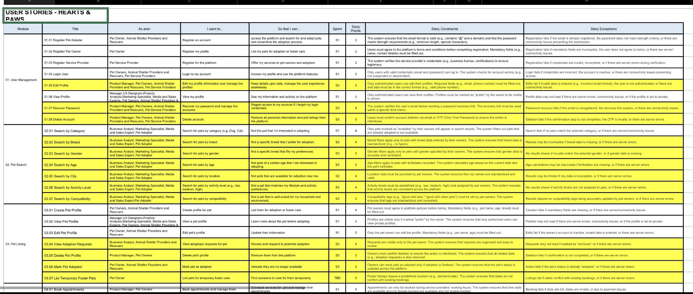
USER STORIES (Lasya Priya)

Slide 8
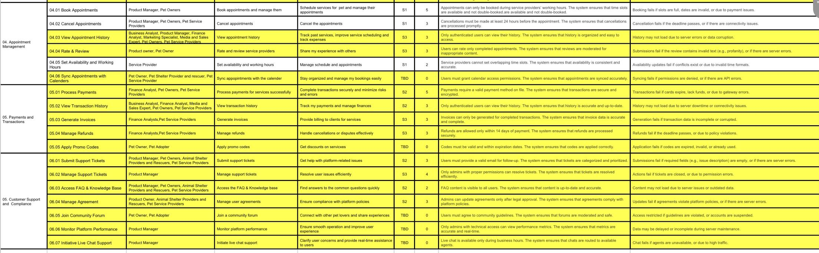
USER STORIES (Lasya Priya)

Slide 9
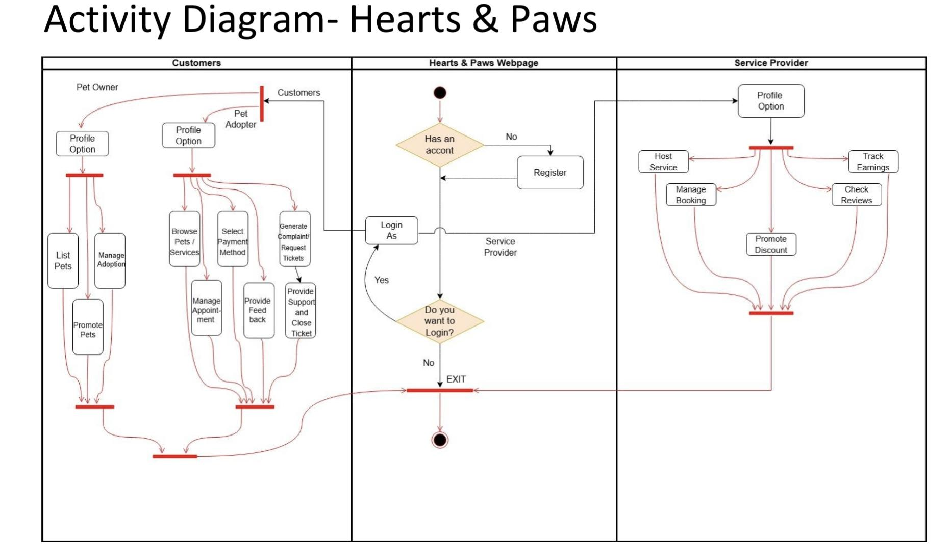
UML ACTIVITY DIAGRAM (Deepak Vemula)

Slide 10
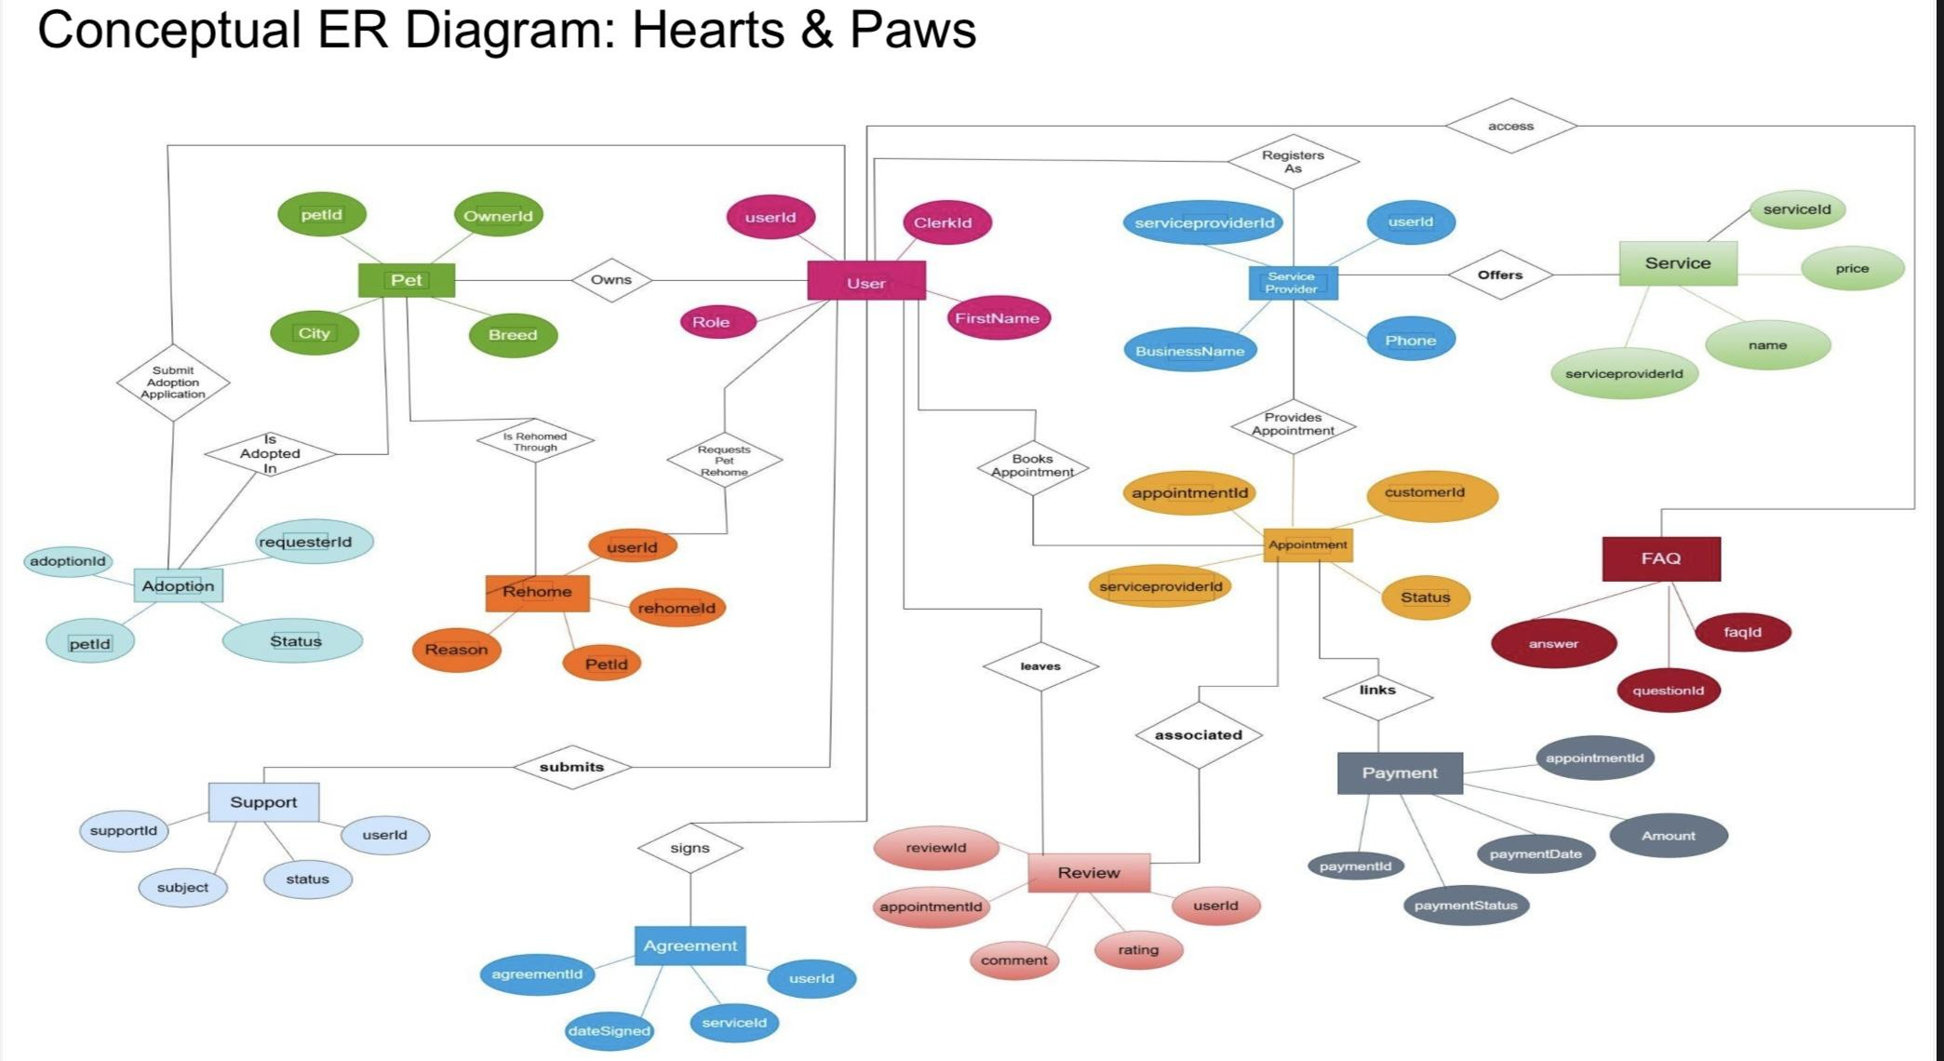
ER DIAGRAM (Vishnu Vardan Pentela)

Slide 11
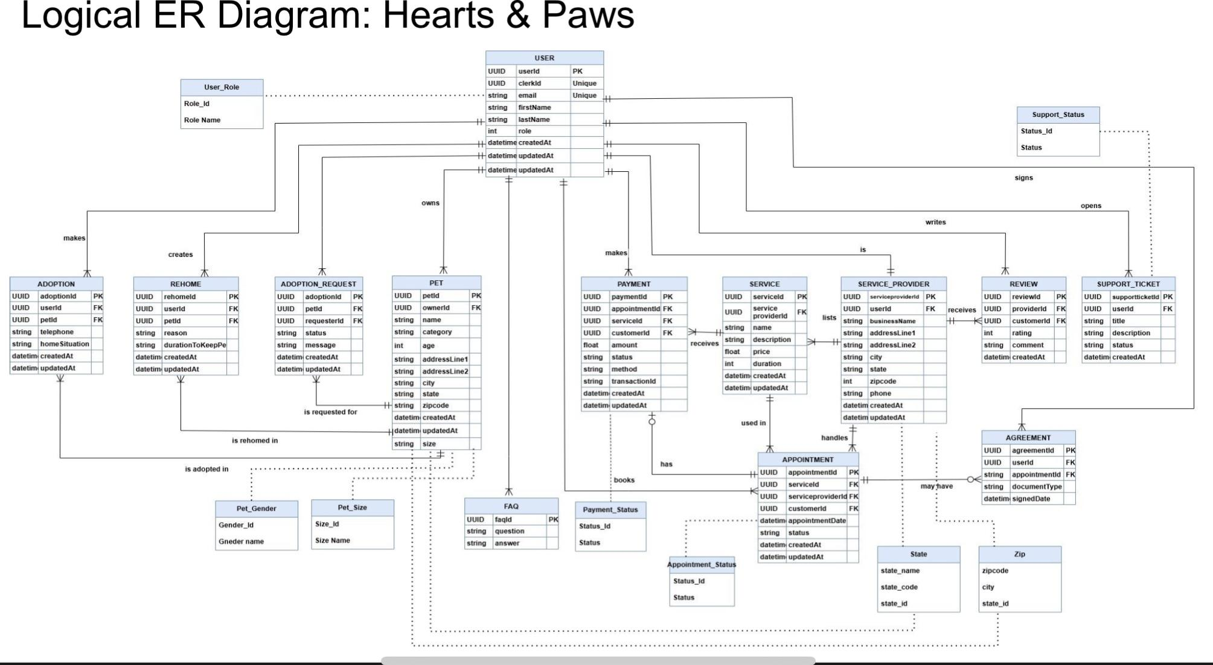
ER DIAGRAM (Vishnu Vardan Pentela)

Slide 12
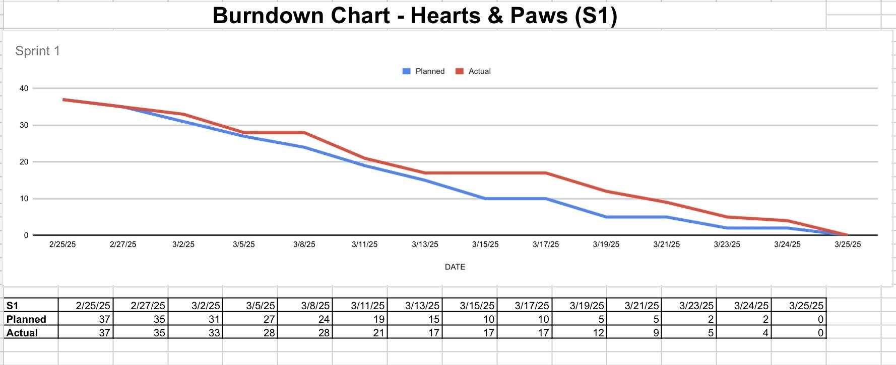
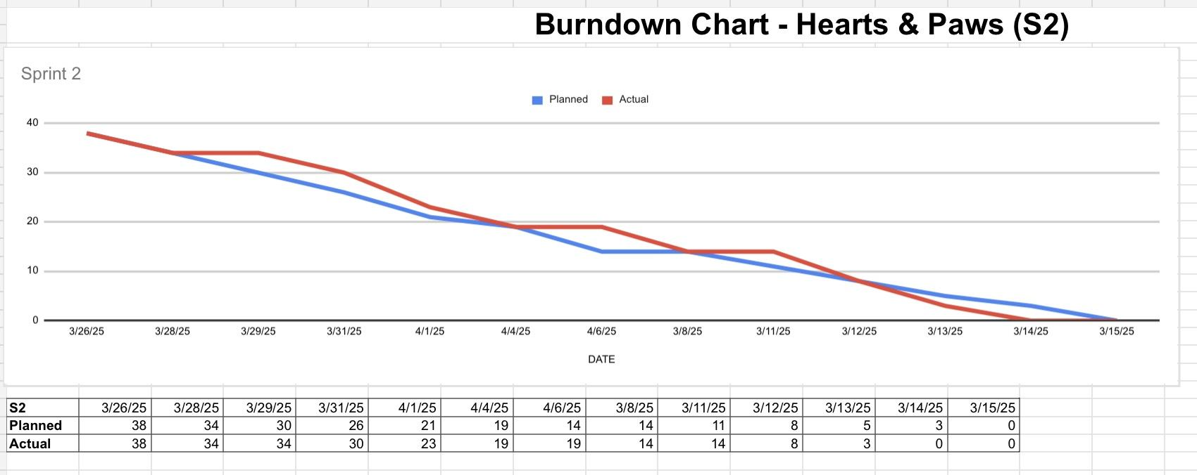
BURNDOWN CHARTS (Kshitij Mahajan)

Slide 13
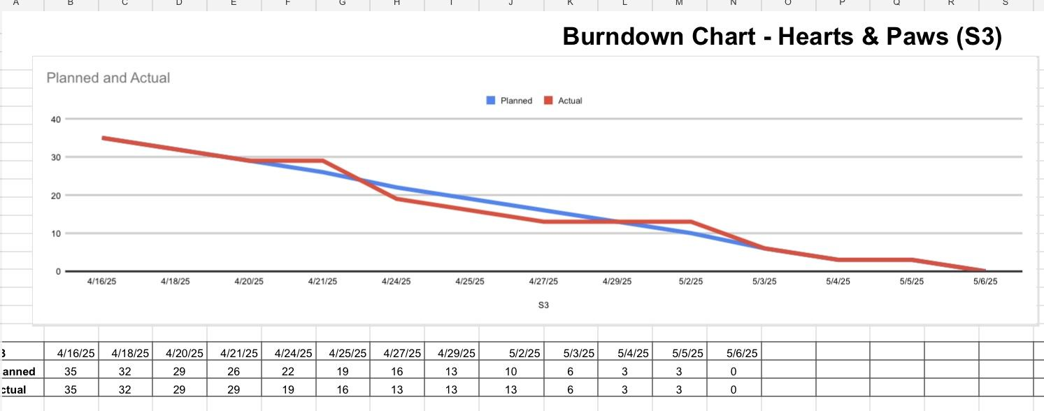
BURNDOWN CHARTS (Kshitij Mahajan)

Slide 14
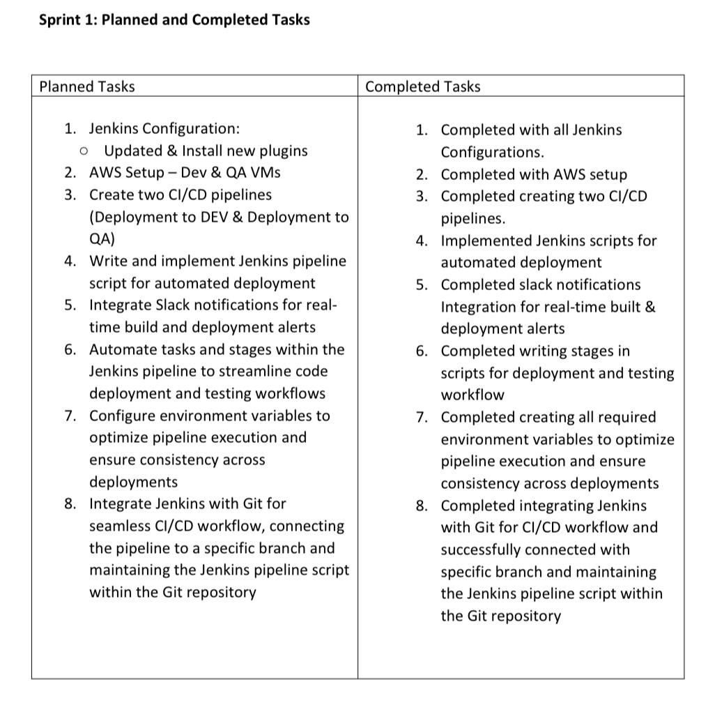
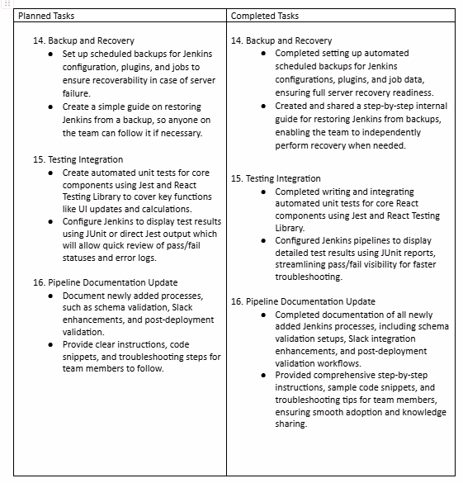
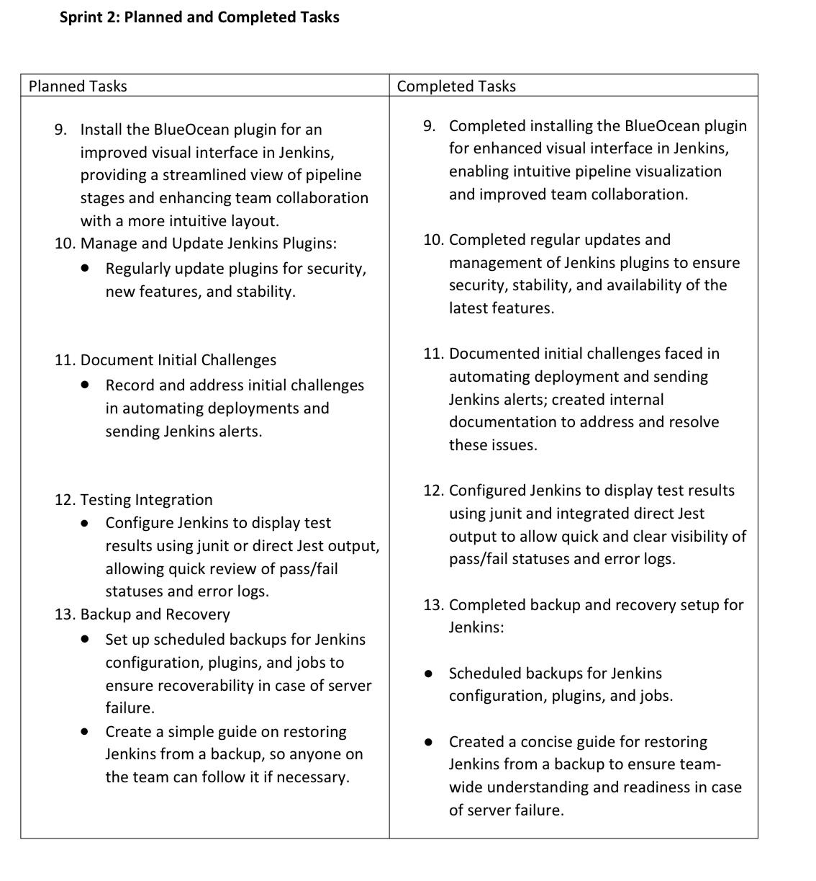
JENKINS PROGRESS REPORT (Ritik Kale)

Slide 15
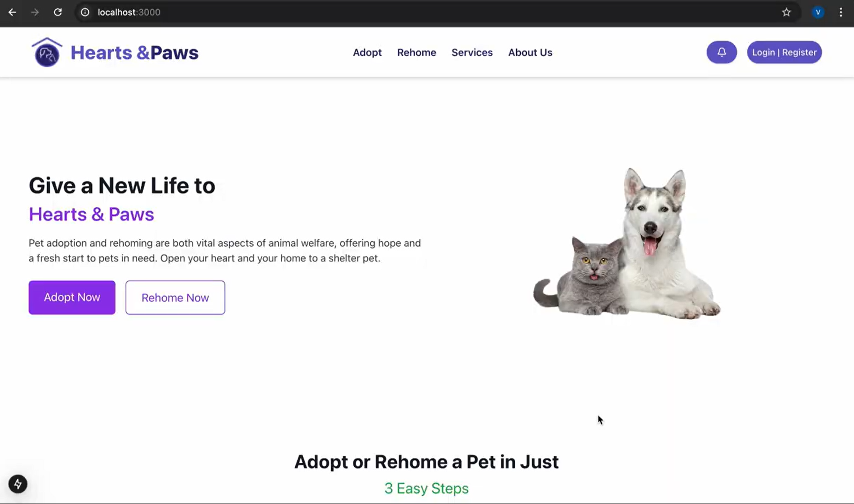
LIVE DEMO (Vrushali Tambat)

Slide 16
THANK YOU!

